Slide 1




Bioinformatics Analysis of Shared Molecular Mechanisms Between SARS-CoV-2 Infection and Alzheimer’s Disease
Under the supervision of:
DR: mohmed elsayeh
Presenter:
omar hisham - mohmed ashour - soha yehia

Slide 2
Introduction
SARS-CoV-2 infection is increasingly associated with neurological and cognitive complications beyond its respiratory manifestations
Neurodegenerative diseases, particularly Alzheimer’s disease, are driven by complex molecular mechanisms including neuroinflammation, immune dysregulation, and protein misfolding
Bioinformatics approaches enable systematic identification of shared genes and pathways, providing insights into potential molecular links between viral infection and neurodegeneration

Slide 3
Background
COVID-19 has neurological effects
Alzheimer’s disease is a major neurodegenerative disorder
Shared molecular mechanisms are suggested

Slide 4
Aim & Objectives
Aim: Identify shared molecular mechanisms between SARS-CoV-2 and Alzheimer’s disease
Objectives:
Identify DEGs
Find shared genes
Perform pathway analysis

Slide 5
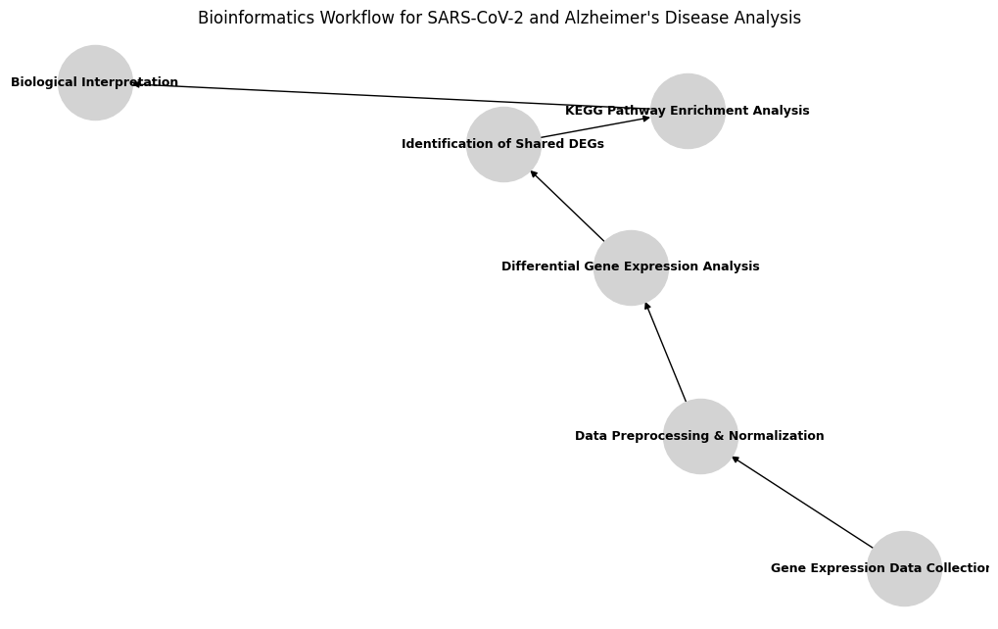
Methodology
Gene expression datasets from GEO
Differential expression analysis
Shared gene identification
KEGG pathway enrichment
Figure 1:Bioinformatics workflow used to identify shared molecular mechanisms between SARS-CoV-2 infection and Alzheimer’s disease.

Slide 6
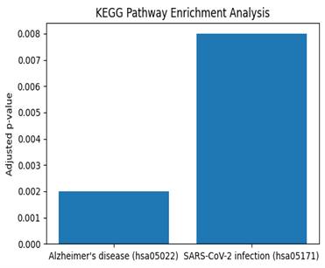
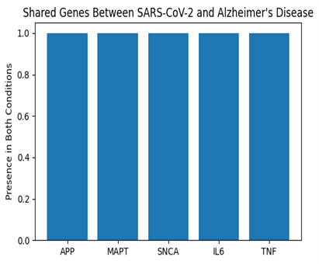
Results
Figure 3: Representative genes shared between
SARS-CoV-2 infection and Alzheimer’s disease.
Figure 2: KEGG pathway enrichment highlighting Alzheimer’s disease and SARS-CoV-2 infection pathways.

Slide 7
Interpretation
Shared genes are related to neuroinflammation
Immune pathways are involved
Possible neurodegenerative link

Slide 8
Future Work
Prion-related mechanisms
Role of non-coding RNAs
Other neurodegenerative diseases

Slide 9
Conclusion
Shared molecular pathways identified
Bioinformatics provides insights
Relevance to COVID-19 neurological effects

Slide 10
Thank You for Your Attention

